Slide 1
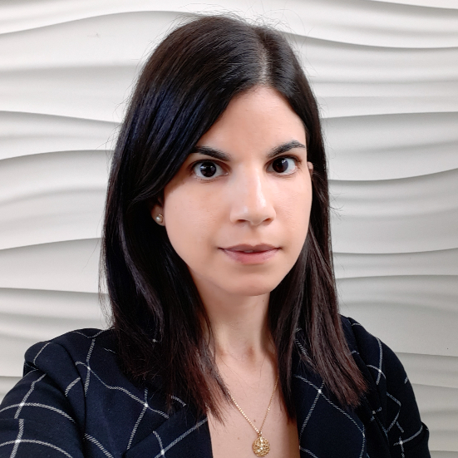
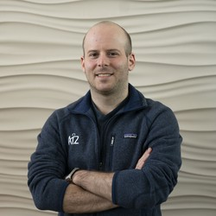
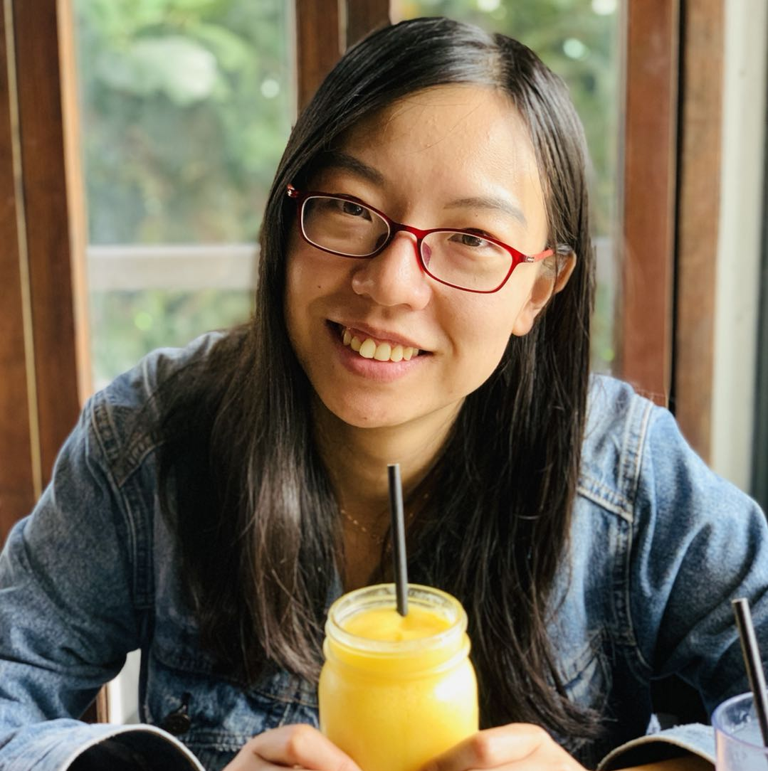
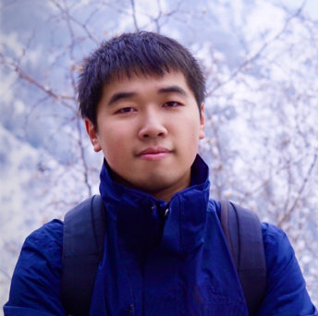
Vered Shwartz
(AI2 & UW)
Antoine Bosselut
(Stanford & EPFL)
Xiang Lorraine Li
(UMass Amherst)
Bill Yuchen Lin
(USC)

Slide 2
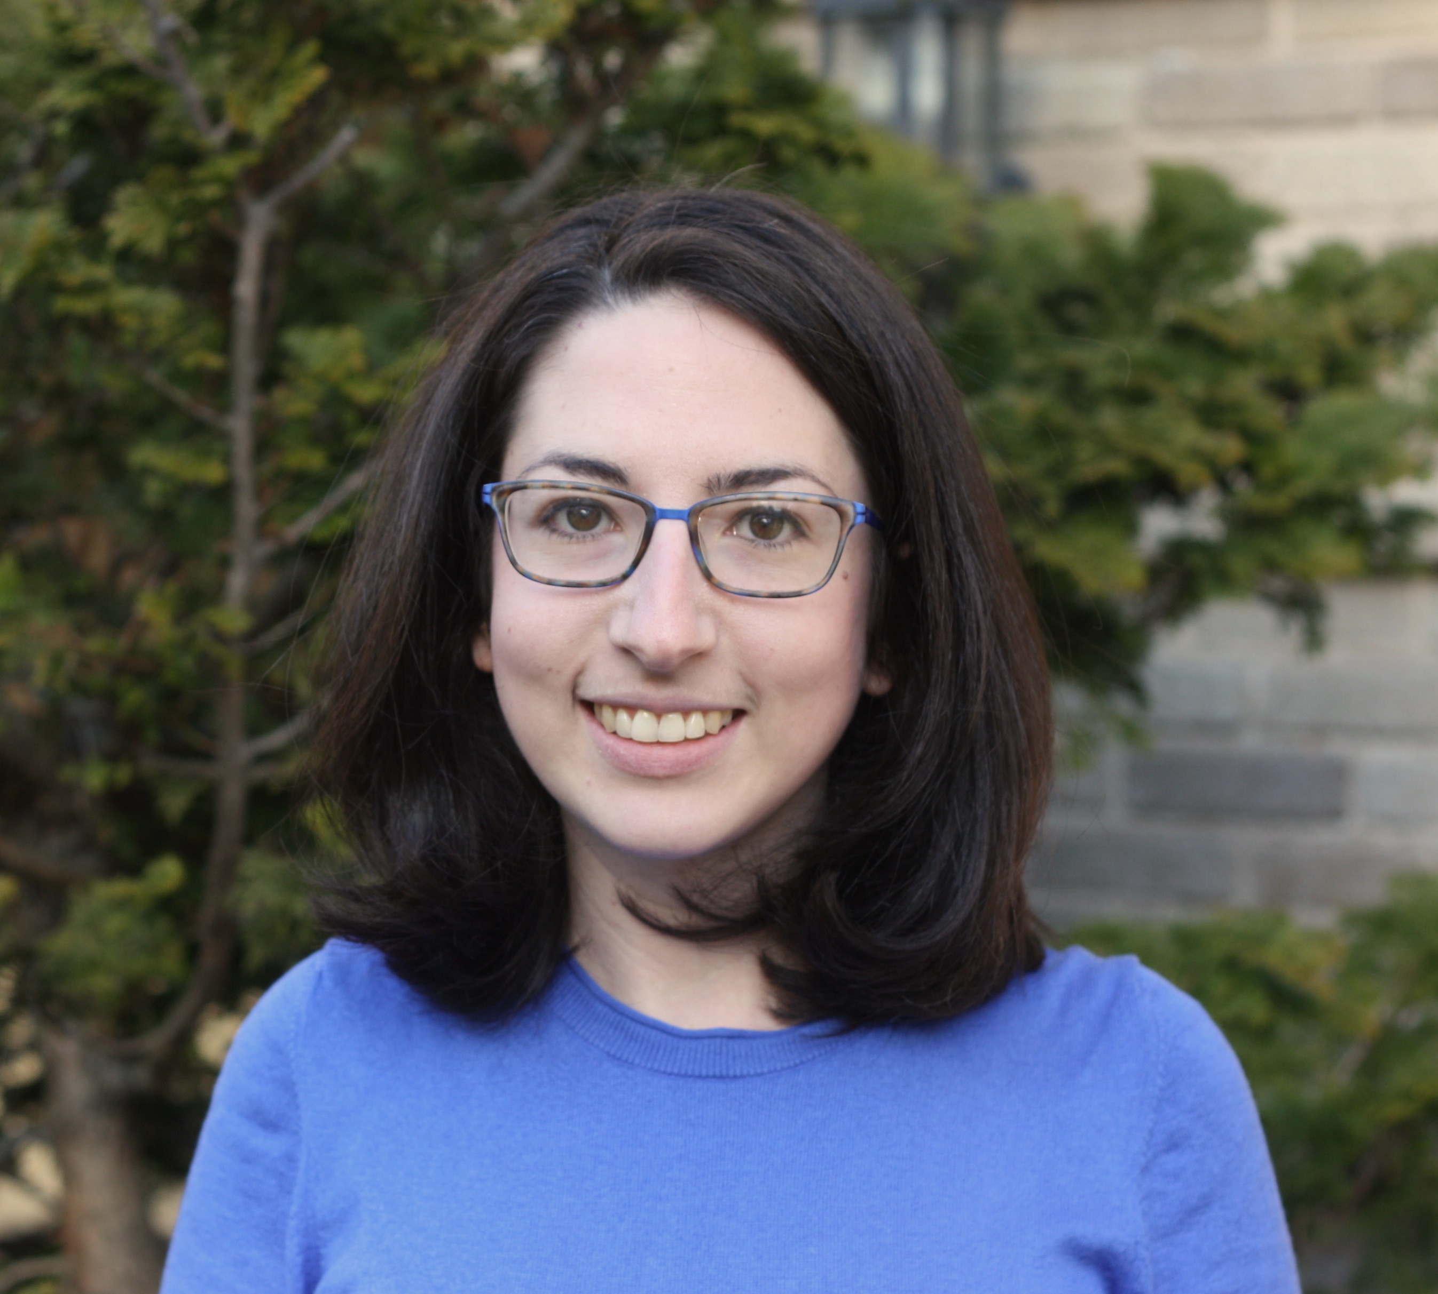
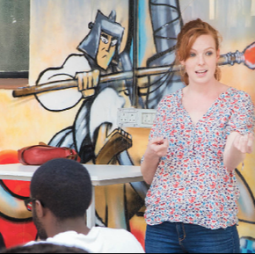
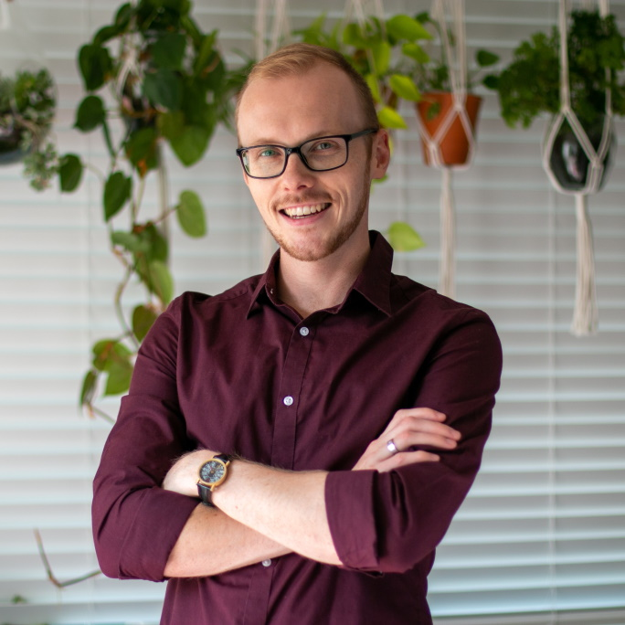
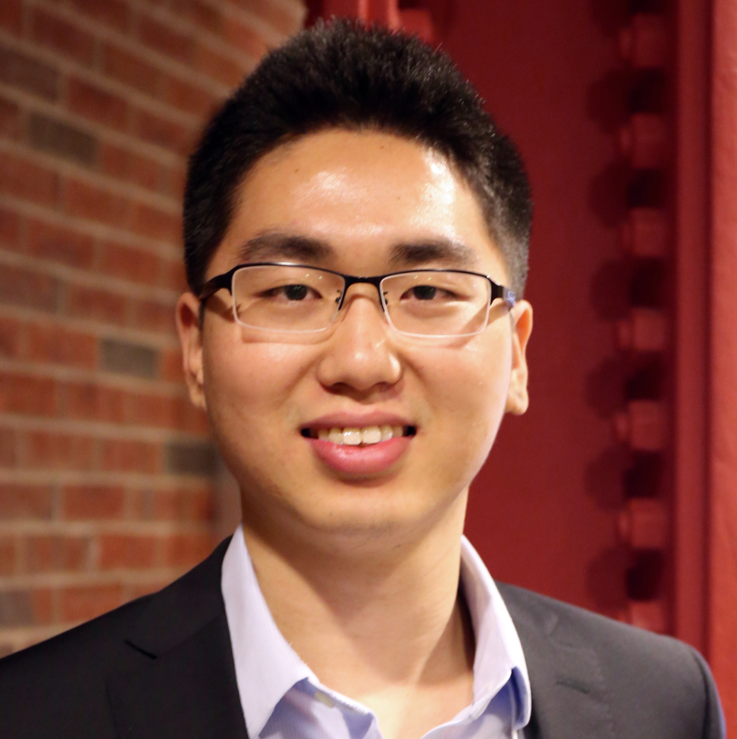
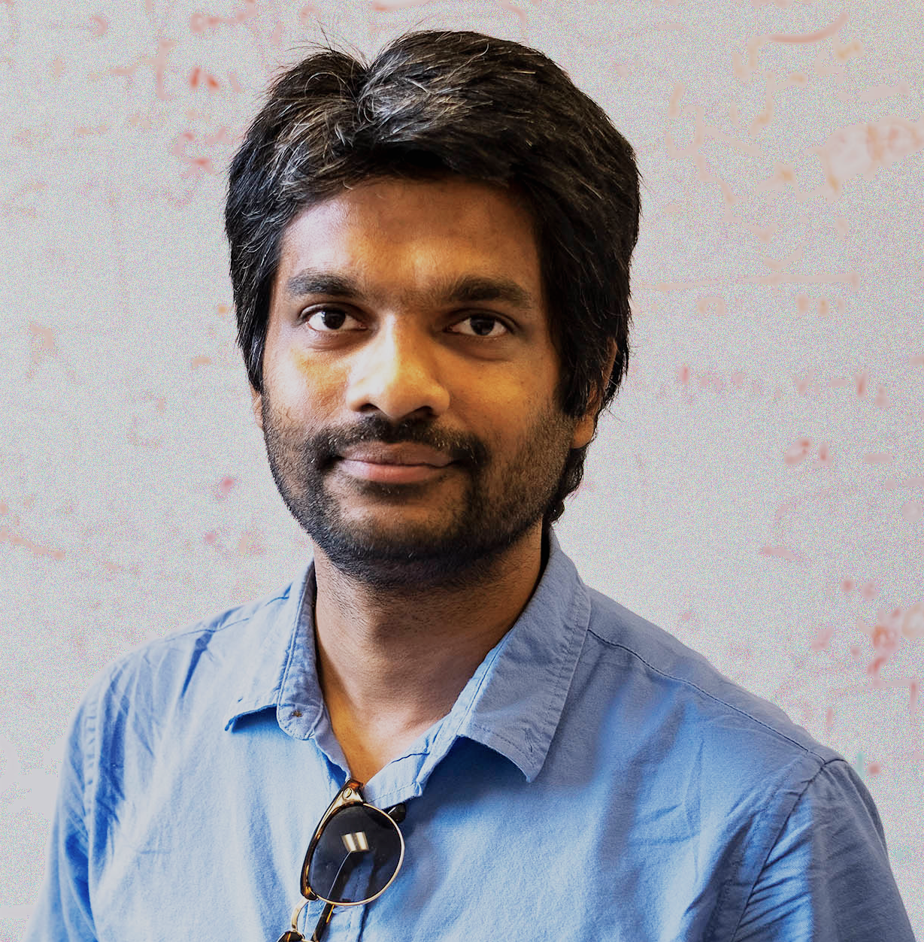
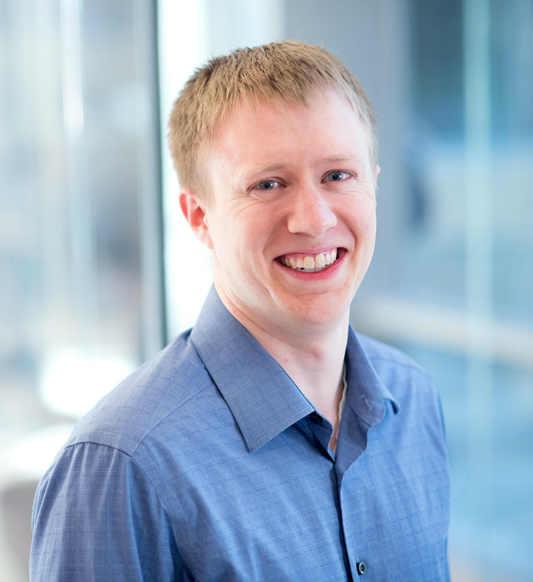
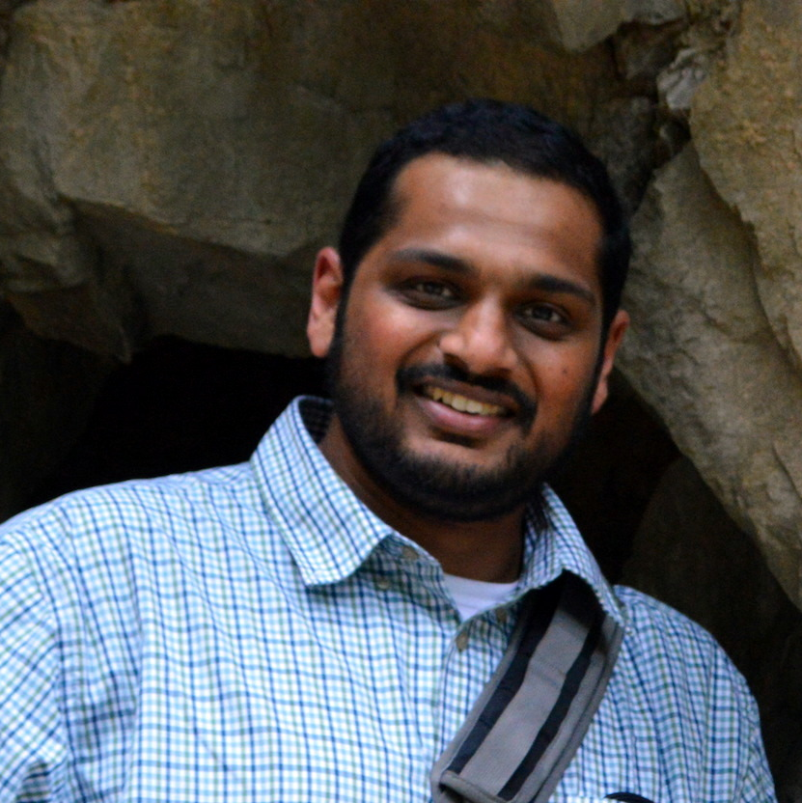
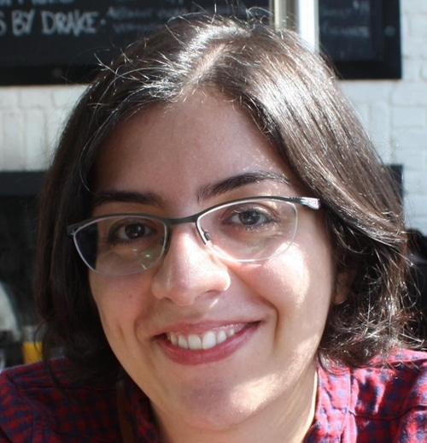
Rachel Rudinger
(University of Maryland)
Sara Hooker
(Google Brain)
Maarten Sap
(AI2 & CMU)
Xiang Ren
(USC)
Mohit Bansal
(UNC)
Greg Durrett
(UT Austin)
Sameer Singh
(UC Irvine)
Aida Nematzadeh
(DeepMind)

